Slide 1
Photoelectric effect

Slide 2
The experiment of Heinrich Hertz
In the year 1887
Through glass a weak spark, through quartz a stronger spark
Conclusion: When illuminated with UV light, the electrons escape from the surface of the metal more easily

Slide 3
Assumptions from classical (wave) theory
Number of ejected electrons is proportional to the intensity of the incident light
Whether electrons are ejected is dependent on the intensity of light
The maximum kinetic energy of the electrons depends on the intensity of the light
At low intensities, some time is needed in order to eject electrons

Slide 4
Testing for photoelectic effect
We measure the volt-ampere characteristics

Slide 5
Conclusions about the photoelectric effect
The number of ejected electrons is proportional to the intensity of the incident light
Whether electrons are ejected is dependent on the frequency of the light
The maximum kinetic energy of the electrons depends on the frequency of the light
At low intensities, electrons are ejected immediately

Slide 6
...from previous lessons
Energy is radiated in quanta.
$$E=nhf$$
Max Planck (1858-1947)

Slide 7
Explanation
Energy is radiated
and absorbed
in quanta
PHOTONS
Albert Einstein
(1879-1955)

Slide 8
Photons
Light quanta
Always moving at the speed of light
Energy
Simultaneously a wave and a particle
$$E=hf$$

Slide 10
What is the role of photons in the photoelectric effect?

Slide 11
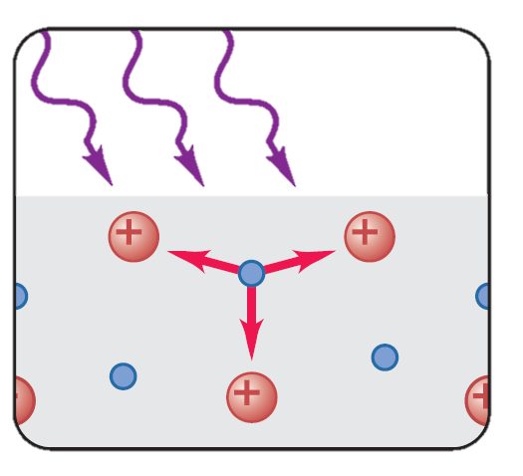
Work function
New physical quantity!
Energy required for the electron to leave the metal
Property of the metal
Notation: А

Slide 12
Einstein's equation for the photoelectric effect
$$hf=A+\frac{mv^{2}}{2}$$
The energy of the photon (hf) is used to overcome the work function (A), and the exess is turned into kinetic energy of the electron.
Conservation of energy!!!

Slide 13
Conclusions about the photoelectric effect
The number of ejected electrons is proportional to the intensity of the incident light
Whether electrons are ejected is dependent on the frequency of the light
The maximum kinetic energy of the electrons depends on the frequency of the light
At low intensities, electrons are ejected immediately

Slide 14
The number of ejected electrons is proportional to the intensity of the incident light
Intensity is proportional to the number of photons
The more photons, the more ejected electrons
Higher intensity means a larger number of ejected electrons

Slide 15
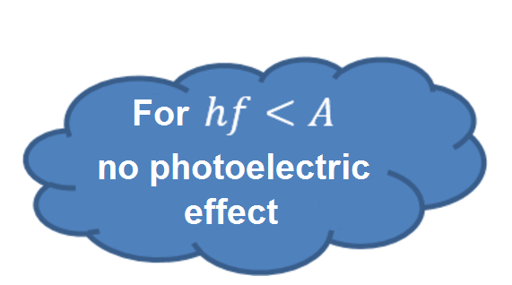
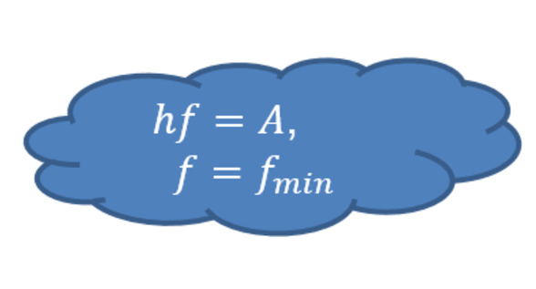
The maximum kinetic energy of the electrons depends on the frequency of the light
$$f_{min}=\frac{A}{h}$$
$$fλ=c$$
$$λ_{max }=\frac{ch}{A}$$
$$λ_{???}=\frac{c}{f_{min}}$$
There is a maximum wavelength for which electrons are ejected

Slide 16
Whether electrons are ejected is dependent on the frequency of the light
$$hf=A+\frac{mv^{2}}{2}$$
$$hf=A+E_{k}$$
$$E_{k}=hf−A$$
For higher frequency the electrons have a higher kinetic energy

Slide 17
At low intensities, electrons are ejected immediately
Photoelectric effect as a collision between two particles
The electron absorbs the energy in a very short time (almost immediately)
No delay at low intensity

Slide 18
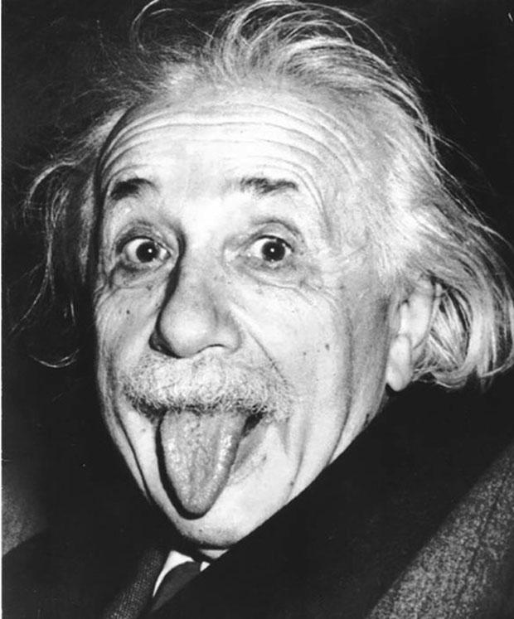
Main ideas
Light is transmitted as photons
Photons are light quanta
A photon is both a wave and a particle
The photoelectric effect is explained by the existence of photons
This lead to significant developements in science and technology
Thank you, Einstein!

